Slide 1









Post-Brexit Data Protection in the UK
22 February 2023 – Jack Featherstone
Notes:
Reason Picked
Newfound knowledge
Any Questions

Slide 2


Table of Contents
01
introduction
02
History of Data Privacy laws
03
Adequacy Decision
04
Divergence vs ALIGNMENT
2
Notes:
Brings together
Brief History
The evolution of a data protection framework
And lastly describe

Slide 3
Data Protection Timeline
Data Protection Act
Data Protection Act 2018
The Privacy Act
Adequacy Decision
1970
1998
2018
2022
1995
2016
2020
Data Protection Directive
Adopted GDPR
Transition Period
3
Notes:
Full control to the data subject
Government handle
Focus shifted
As time passed
Key criteria processing lawful
Implemented independently
EU and UK future relationship
Still adhered to EU law
Comparable protection
Free flow contingent

Slide 4



Adequacy Decision
28/06/2022
Opportunity To Diverge ?
No Alternative Rollout
Economic Necessity
Business Cost
4
Notes:
By those who viewed GDPR standards too high
Begs the question
UK gov didn’t comply
Despite GDPR strict rules

Slide 5



Access To Markets
Cost of multiple regimes
5
Notes:
Throughout research
Eu one of the largest trading blocs in the EU
These international companies adopt EU regulations not only to access to the markets but also
Consistent process throughout your business
Companies outside of EU now taking GDPR as norm, so for very large companies no desire to diverge

Slide 6
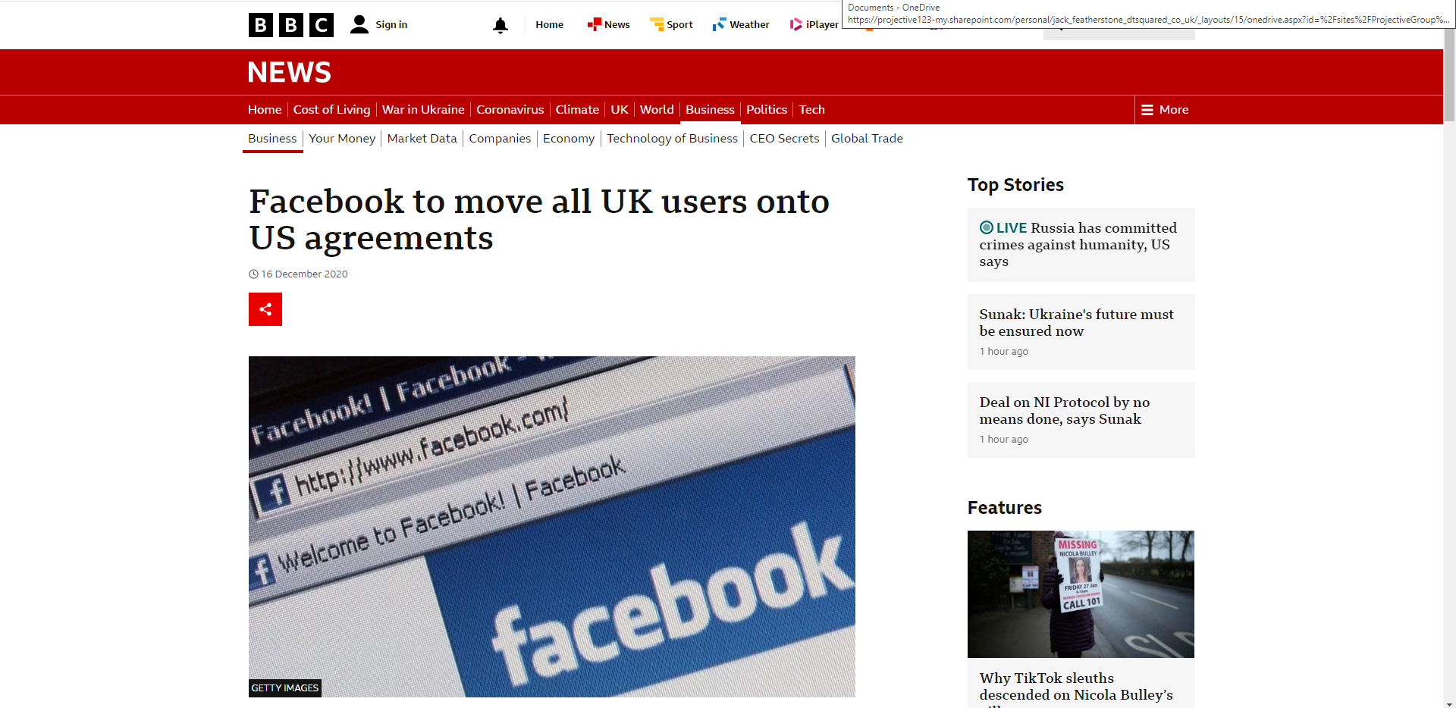
6
Notes:
Compliance burden of two jurisdictions (UK GDPR and EU GDPR)
User Agreements to California as UK’s predicament is too unpredictable. The fact that they were able to remove thousand of user profiles out of the worlds most stringent regulations was just an added bonus.

Slide 7
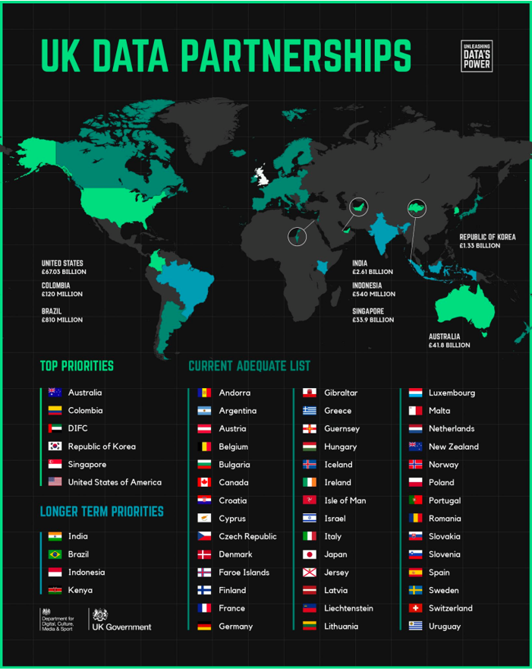
'We Intend to expand the list of adequate destinations in line with our global ambitions and commitment to high standards of data protection'
7
Notes:
For the UK to secure an adequacy decision
Current UK protection system
Companies that abide by the former would usually abide by the other
Transfers of personal data outside the UK
Reclaim regulatory autonomy
Quote by the gov … statement will be welcomed by those calling for Brexit
Welcomed by those who wished to diverge away from GDPR
However it is important to note the Uk’s own adequacy decision

Slide 8


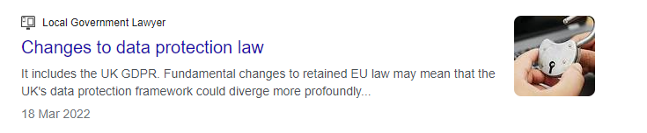

‘The UK will in the future develop separate and independent policies in areas such as data protection’
8
Notes:
Indicate that the gov might Seek its own data protection path
One suggestion may include creating a new data protection framework
Last slide I'm just going to go through reasons for and against diverging against GDPR

Slide 9
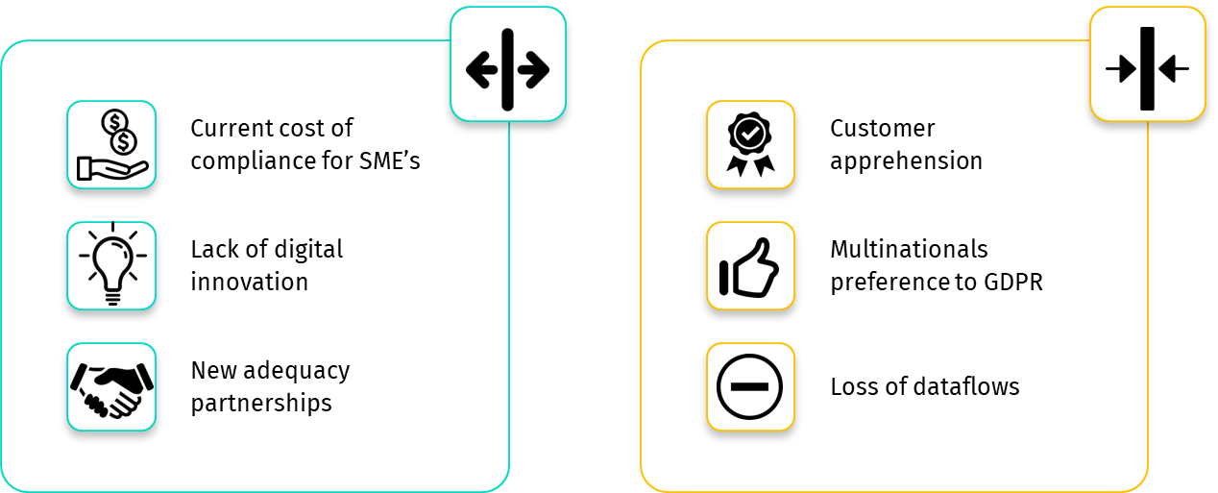
Divergence vs Alignment
9
Notes:
Smaller businesses effected
Lack of clarity over how the rules relate to emerging technologies
Ability to create new or stronger trade links beyond EU
Divergence from the GDPR not an appropriate response given customers higher value put on data protection
Companies operating in both EU and UK promote continued compliance rather than multiplicity
Loss of data flows if significant divergence
My views
Divergence not to be loud or pressing for as long as Eu remains an important trading bloc and multi-nationals operating on a global basis support compliance
Not to say that GDPR is bullet proof it must remain fit for purpose. The EU should not ignore the concerns raised that it hampers innovation and competitiveness. EU data protection advocates have rightly framed the UK’s continued compliance with the GDPR as early evidence of the potential for the EU to set the standard of data protection laws and encouraging harmonization on a global basis. The UK has left the EU but not EU data protection law behind.

Slide 10


Any Questions ?
Notes:
Benefit from Info : Since the UK left the EU -> Hectic (Law practitioners) -> staying up to date vital on keeping an eye on whole range of thoughts -> Don’t necessarily have to be a business with offices in UK and EU -> obtain knowledge on specific aspects on current policies.
Stunting Innovation : So, for A.I, the way these algorithm train is on an amass of data (to avoid bias in the results), unfortunately still, a vast some of data comes from outside the EU, this is creating a stunt in its actual growth as well as jeopardizing our future innovation.
Why some partnerships over others : The purpose of these partnerships is to share crucial information (life saving research as well as cutting edge technology) as well as build on the 80 Bn data enabled service exports
Alternative to Adequacy Decision : GDPR as a wide range of tools in its toolbox to aid in the flow of data from the UK to the EU, one of these include Standard Contract Clauses.
Multiple Regimes : So more regimes mean additional costs, these costs come in the form of Time and Money.
Time in creating these additional documents, and money in following the correct procedures.
GDPR Harmonize : GDPR was supposed to provide security and harmonization, security in the form of imposing fines and following regulation
What is involved in Adequacy Assessment Tests ? Is it worth commencing an assessment ? What level of protection do they have ? Their Recommendation ? Laid in front of Westminster ?
Should Businesses Be worried ? If your organization operates in the EEA, you need to comply with both protection regulations. Although as they are so similar a business that complies with one with comply with the other. The transition be seamless. If your business is reliant on EU data flows its worth keeping an eye on changes in law.
DPA 2018 was the domestic implementation of GDPR now UK GDPR.

